Slide 1
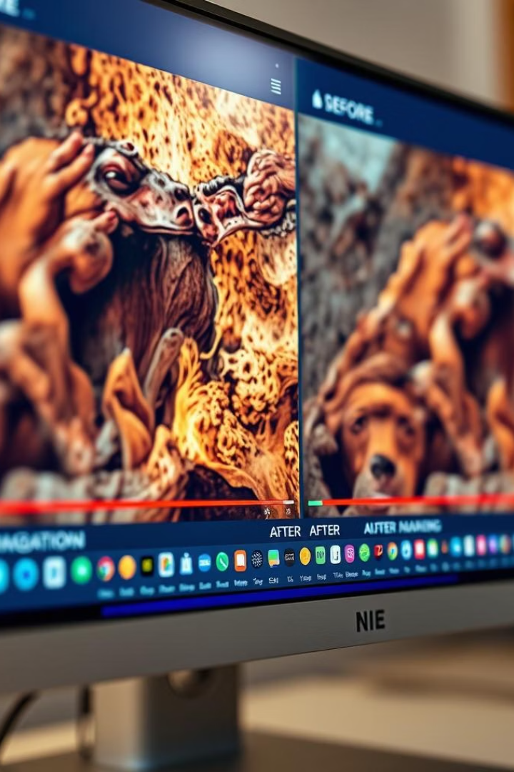

ChromaVision: AI-Powered Video Enhancement
Welcome to ChromaVision's project report.
We present our modular system for video colorization, detection, and upscaling powered by AI.
by Tushar Harsan

Slide 2

Project Overview & Declaration
Project Scope
Declaration
ChromaVision enhances and analyzes video content with AI.
Original work, not submitted elsewhere.
Developed Jan–Apr 2025 at Bennett University.
All results authentic and documented.

Slide 3
Acknowledgement & Table of Contents
Acknowledgement
Contents
Gratitude to mentor Sanchali Das, VC, Dean, HOD, faculty, and peers.
Abstract
Introduction & Problem Statement
Background Research
System Design
User Interface
Algorithms & Closure

Slide 4

Abstract & Problem Statement
Abstract
Problem
Need
ChromaVision uses GANs, YOLO, Vertex AI for enhanced video analysis.
Existing surveillance yields low-quality, grayscale videos.
Demand for automated AI-powered video enhancement and navigation.
Manual analysis is slow and lacks automation.

Slide 5
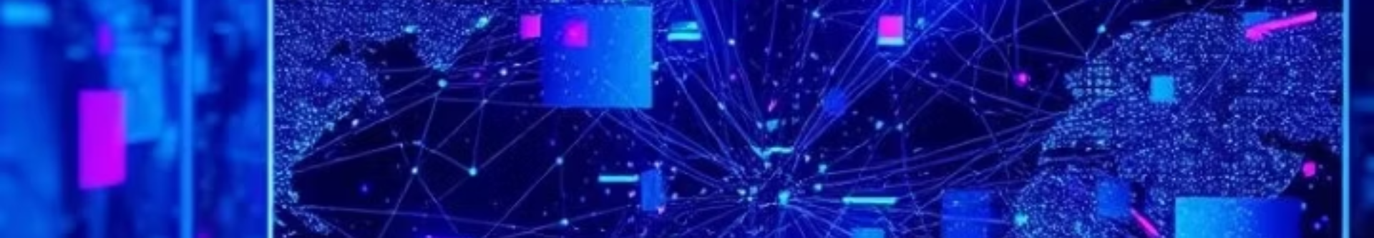

Background Research & Technology
GANs
Used for colorization and super-resolution reconstruction.
YOLO
Enables real-time, high-accuracy object detection.
Vertex AI
Provides scalable cloud infrastructure for ML deployment.

Slide 6





Proposed System & Objectives
Upscaling
Object Detection
Colorization
Enhance resolution with user-defined parameters.
Detect and timestamp objects/faces via YOLO and Vertex AI.
Convert grayscale video to HDR using GANs.
User Interface
Extensibility
Seamless interaction with all system features.
Support for future AI models and formats.

Slide 7
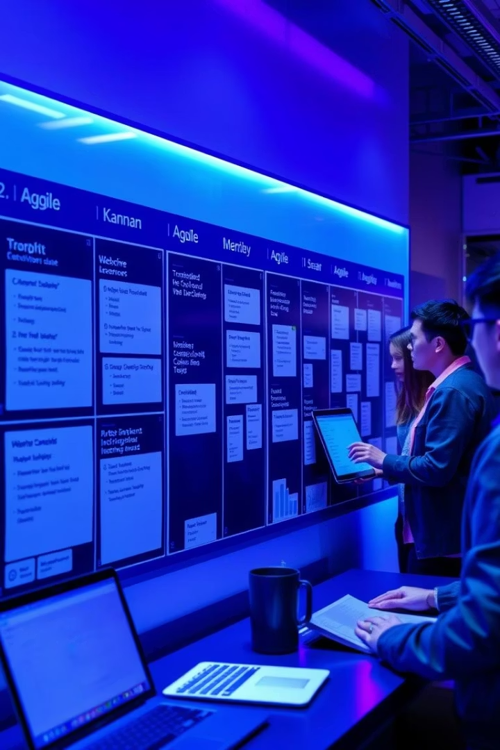
Project Planning & Tracking
1
Agile Sprints
Three sprints: requirements, prototyping, integration/UI.
2
Setup & Resources
Python, TensorFlow, YOLOv8, Google Cloud, GPU servers.
3
Stakeholders
Team members and mentor actively engaged.
4
Tracking
Code on GitHub, bugs via Jira, documentation in Google Drive.
CI/CD with GitHub Actions ensures quality delivery.

Slide 8
System Design, UI & Project Closure
System Design
User Interface
Integrated modules: colorization, detection, upscaling.
Web interface enabling easy feature access.
Includes use case, class, activity, and sequence diagrams.
Closure & Future Work
Delivered solution meets objectives.
Plans for real-time processing and mobile apps.
Target users include security analysts, developers, and end users.

Slide 9
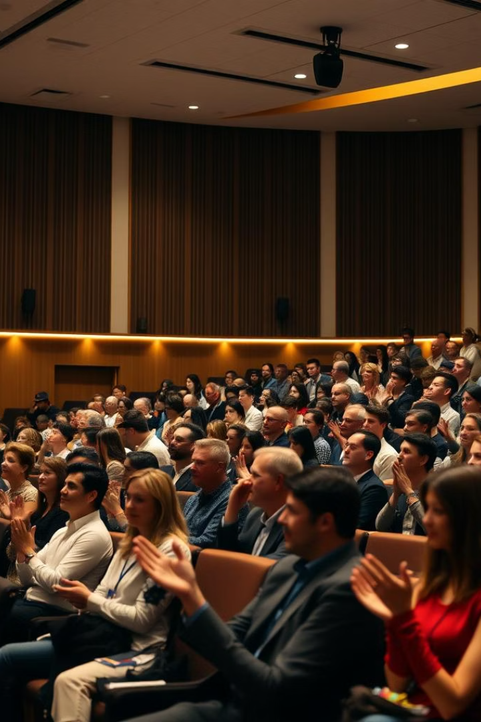
Thank You
We appreciate your attention and interest in ChromaVision's advancement.
Questions and collaboration invitations are warmly welcomed.

